Slide 1

Data-Driven Analysis of Mortgage Costs in Spain
Project @Ironhack
April 26, 2025
Anastasia Samoylova

Slide 2


What Drives Mortgage Costs in Spain?
Mortgage costs vary depending on bank, customer profile, and conditions.
There is no central, public database of Spanish mortgage offers.
My goal: analyze how different features impact the mortgage cost - the APR.
APR (Annual Percentage Rate): Represents the total yearly cost of a mortgage, including the interest rate and all costs (insurance, commissions, administrative costs, bank margin)
Notes:
Consumers typically rely on bank websites, mortgage comparison platforms, financial advisors or brokers.
APIs: There are no open, standardized APIs that allow private individuals to retrieve real-time mortgage offer data across banks. Mortgage data remains decentralized and often manually accessible only (tried APIs TrueLayer, Tink - but no access to real data)
the available public data focuses on aggregated statistics:​
- Instituto Nacional de Estadística (INE) publishes monthly reports on mortgage activity, including avg loan amounts, interest rates, and number of mortgages constituted INEbase / Industry, energy and construction /Construction and housing /Mortgage Statistics / Latest data
- Banco de España provides detailed statistics on interest rates applied by financial institutions, covering various loan types and terms. ​Interest rate statistics • BdE
These sources offer valuable insights into the overall mortgage market trends but do not provide real-time, bank-specific mortgage offers.​

Slide 3

Methodology: How I collected the Data
Used real bank simulators
Collected data manually from 16 banks
Defined the base scenario for the investment and the applier
Simulated 118 different loan scenarios
Added data like bank type and bank description

Slide 4

Dataset Summary
Let’s dive in

Slide 5
What the Data Looks Like
Collected Data
Base Case
118 loan simulations
Features:
APR in %
Loan Term (15y – 30y)
Bonus Conditions (No Bonus/Bonus)
Customer Type (Resident/No-Resident)
Bank Type (Traditional/Digital)
Bank Description
Investment:
Loan amount: 100 k€ (property price: 150 k€)
Location: Madrid
Usage: Primary Residence
Property type: Second-hand
Applier:
Net income: 2 k€/month
Residency: Spanish resident
Age: 32 years

Slide 6

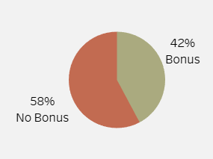
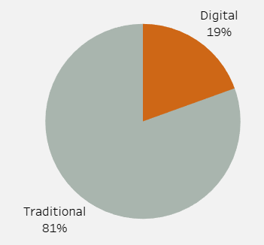
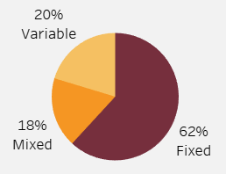
Main Feature Distributions
Data availability, not market reality: Feature distributions reflect what was accessible via public simulations — not a true market representation.
Traditional banks overrepresented: Due to greater data transparency from traditional banks, more offers were collected from them.
Fixed-interest loans dominate because they allow for a consistent APR comparison. Some banks only provide variable or mixed loan simulations, so they were added to enrich analysis.
Bonus condition split: While most banks promote bonus-linked loans, not all do — resulting in a near 58/42 distribution.
Notes:
The distributions you see here are a direct result of how the data was gathered, not how the Spanish mortgage market is structured.
Traditional banks are more represented simply because more of them offer accessible simulations. Digital banks are growing but still lag in publicly available offer data.
Fixed loans were prioritized intentionally — they offer the most consistent way to compare APRs. However, since some banks only provide variable or mixed options online, those were included to avoid excluding valuable offers.
Lastly, bonus conditions appear almost evenly split — many banks require certain conditions like bundled insurance for better rates, but others don’t, which reflects in the dataset.

Slide 7

Dashboard and Insights
Let’s dive into Tableau

Slide 8
Key Statistical Finding
Feature | Test Type | APR Diff | p-value | Effect | Notes
Bank Type | t-test | 0.9 | 0.00 | Digital banks offer lower APRs
Customer Type | t-test | 0.8 | 0.00 | Residents get better APRs | Limited data with 2 banks only
Bonus Conditions | t-test | 0.3 | 0.02 | Bonus conditions reduce APR
Loan Term (pricing strategy) | t-test | 0.2 | 0.16 | No significant overall difference
Loan Term (Increase Group) | ANOVA | - | 0.88 | APR remains stable across loan terms | No within-group variation despite increasing trend
Loan Term (Decrease Group) | ANOVA | - | 0.94 | APR remains stable across loan terms | Lower APRs overall, but not significantly changing by term

Slide 9
Thank you for following this analysis journey with me.

